Slide 1
Code base for Spring Boot Restful and gRPC

Slide 2
Content
Current code base
The idea
Models and DTOs
Lombok
Mapstruct
Services and DAOs
Controllers
API Response and Exception Handling
The other packages
II. gRPC integration
gRPC components
Code generation
Server implementation
Client implementation
Integration

Slide 3
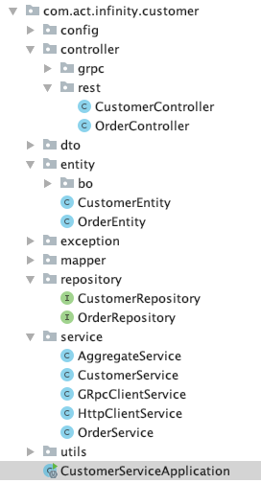
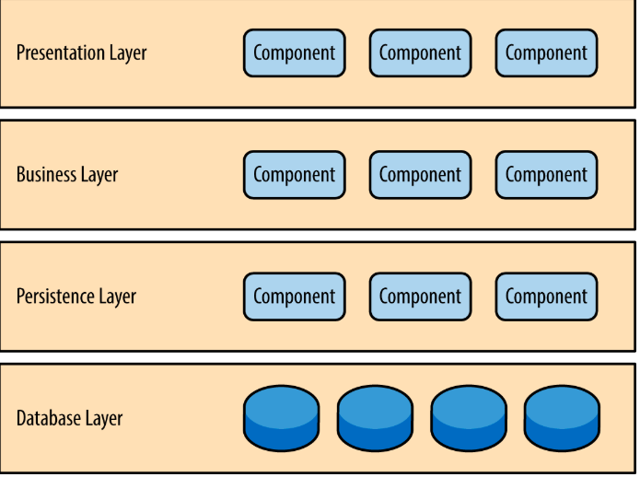
Main idea:
Base on Layered Architecture

Slide 4
Entities and DTOs
Various models under “entity” package and the DTOs under “dto” package
Entities (or models) is the representation of database entities. Each entity should be mapped with the one in the table object of database
DTOs let us transfer only the data that we need share with the user interface and NOT the ENTIRE model object
DTOs may have aggregated using several sub-objects and persisted in the database

Slide 5
Lombok
What is?
A java library that automatically plugs into your editor and build tools
Never write another getter and equals method again, with one annotation your class has a fully featured builder
Automate your logginging variables
Why Lombok for DTOs and models?
Reduce boilerplate code
Save development time and effort
Make the code lot more readable
Important annotations:
@Getter /@Setter
@ToString
@EqualsAndHashCode
@Data: A shortcut for @ToString, @EqualsAndHashCode, @Getter on all fields, and @Setter on all non-final fields
@AllArgsConstructor and @NoArgsConstructor
@Slf4j

Slide 6
Mapstruct
MapStruct is a code generator that greatly simplifies the implementation of mapping between Java beans types based on a convention over configuration approach:
Plain method invocations
Fast, type safe and easy to understand
Why?
Multi-layered application often require to map between different object models (e.g. entities and DTOs)
Writing such mapping code is a tedious and error-prone task
Generating bean mappings at compile time which ensure a high performance, allows for fast developer feedback and thorough error checking
In comparison with other Java mapping frameworks: one of the best

Slide 7
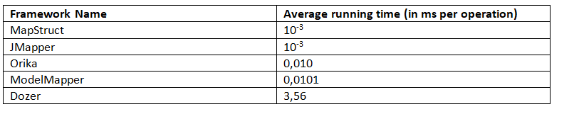
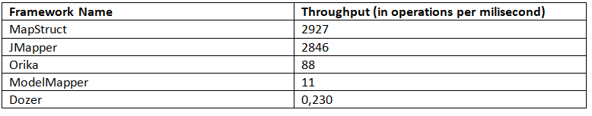
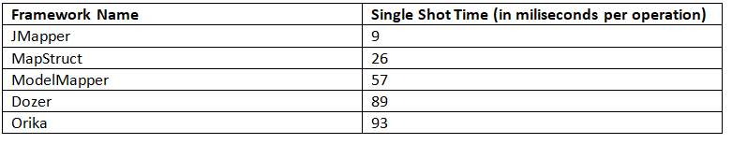
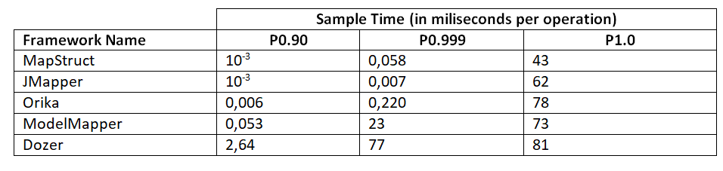
Mapstruct - Comparison
Source: https://www.baeldung.com/java-performance-mapping-frameworks

Slide 8
Services and DAOs
Services under “service” package
DAO classes under “repository” package
DAO classes interact with Database
Service layer NEVER accepts a entity as input and never ever return one either
Service layer received request from controller and perform all necessary action included calling to DAO classes if needed, aggregate query result and converting back to DTO objects

Slide 9
Controller
The most important part, under “controller” package
Define the Uniform Resource Identifier
Bind everything together right from the moment a request is intercepted till the response is prepared and sent back
Interact directly with service layer

Slide 10
API Response and Exception Handling
Response data object DTO
The API response are being sent in a uniform manner using response factory. The class in package “factory” is used for this purpose.
All customize exceptions present in ‘exception’ package
Using Controller Advice

Slide 11
Other packages
Config: configuration classes
Util: the utilities classes and function
Mapper: Mapping between Entity and DTO object. Mapstruct will be used here
Constant

Slide 12
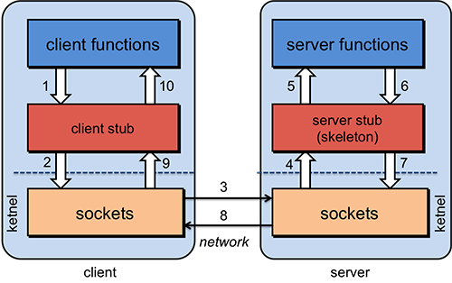
gRPC - the Calling model

Slide 13
gRPC Components
At a high level there are three distinct layers to the library: Stub, Channel, and Transport.
gRPC Stub
The Stub layer is what is exposed to most developers and provides type-safe bindings to whatever datamodel/IDL/interface you are adapting
gRPC comes with a plugin to the protocol-buffers compiler that generates Stub interfaces out of .proto files, but bindings to other datamodel/IDL are easy and encouraged.
gRPC Channel
The Channel layer is an abstraction over Transport handling that is suitable for interception/decoration and exposes more behavior to the application than the Stub layer
It is intended to be easy for application frameworks to use this layer to address cross-cutting concerns such as logging, monitoring, auth, etc
gRPC Transport: gRPC comes with three Transport implementations:
Netty-based: main transport implementation based on Netty
OkHttp-based: It is mainly for use on Android and is for a client only
The in-process transport is for when a server is in the same process as the client. It is useful for testing, while also being safe for production use.
Notes:
Netty is an asynchronous event-driven network application framework for rapid development of maintainable high performance protocol servers & clients
The OkHttp-based transport is a lightweight transport based on OkHttp. It is mainly for use on Android and is for client only.

Slide 14
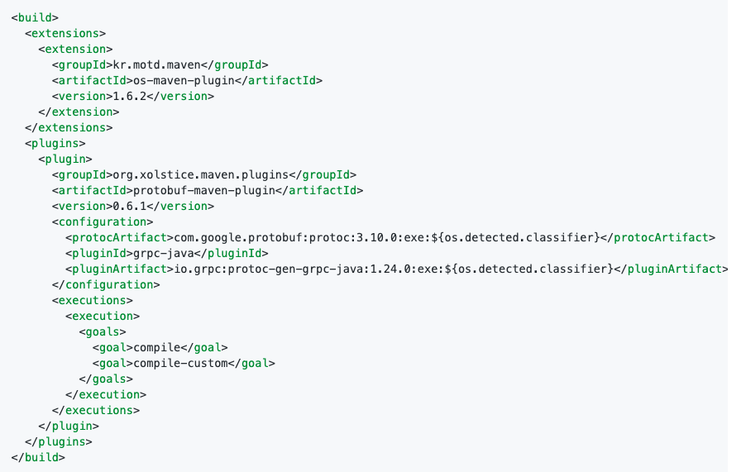
Code generation
Install Protocol Buffer Compiler then run following command:
protoc --proto_path=IMPORT_PATH --java_out=DST_DIR --python_out=DST_DIR --go_out=DST_DIR path/to/file.proto
Using dependencies when build project

Slide 15
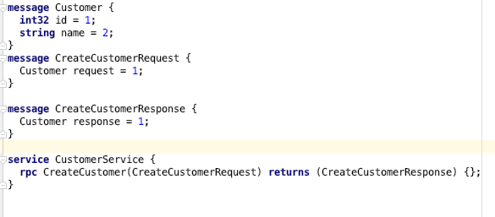
Code generation example
Example .proto file:
Focus on Stub

Slide 16
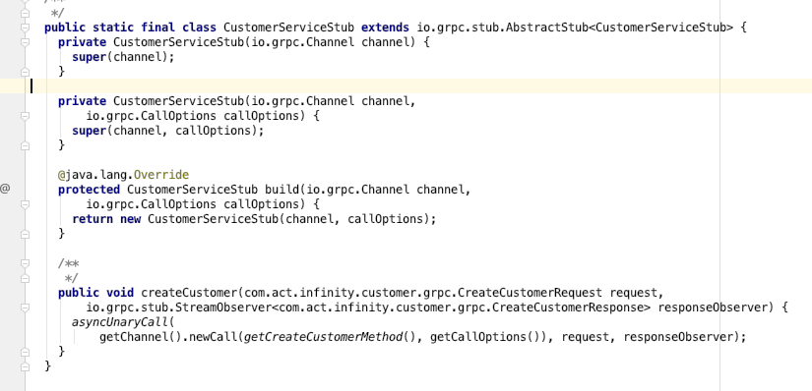
Code generation example (2)

Slide 17
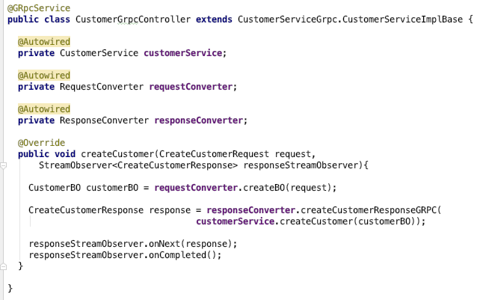

Server implementation
Start by generating stub and server interface(s) from .proto file(s).
Annotate your server interface implementation(s) with @org.lognet.springboot.grpc.GRpcService
Optionally configure the server port in your application.yml/properties. Default port is 6565.

Slide 18
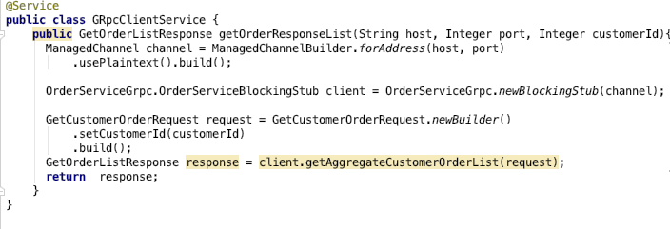
Client implementation
Also start by generating stub and client interface(s) from .proto file(s).
Open the Channel with host and port
Create Stub then do RPC call

Slide 19
gRPC integration to Code base
RPC Endpoint : implementation as a gRPC server. So it need present under “controller” package
Communication with other services via RPC: implement as a gRPC client. It can under the “service” package
Request and Response: generated by declaration in .proto files. So it depend on package declared in .proto files.
Exception: present under package “exception”

Slide 20
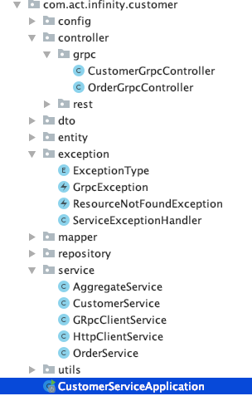
gRPC integration to Code base - Mapping
RPC Endpoint
Communication with other services via RPC
Exception

Slide 21
Appendix: How to write the good protocol buffer files?
Consistent naming: Request have suffix “request”, Response have suffix “response”
Data structure enforcement at the API layer: should not using serialized object to replace primitive type
Unique message for Request and Response: using minimum fields for request and response instead of re-use large object
Enum definitions should have an “unknown” value at 0: because protobuf defaults to the enum constant at ordinal 0

Slide 22
THANK YOU FOR YOUR ATTENTION

